Slide 1

CRICKET WORLD CUP DATABASE
CREATED BY SHIVANSH RAJPUT(229310101) AND ARNAV GUPTA(229310038)

Slide 2

Software Requirement Specification
A Software Requirements Specification (SRS) is a document that describes the nature of a project, software or application. In simple words, SRS document is a manual of a project provided it is prepared before you kick-start a project/application.

Slide 3

Hardware Specifications & Software specification
Processor : i5 Core Processor
Clock speed : 2.5GHz
Monitor : 1024 * 768 Resolution
Keyboard : QWERTY v. RAM : 1 GB
Input Output Console for interaction
MySQL (MySQL Workbench 6.3)

Slide 4
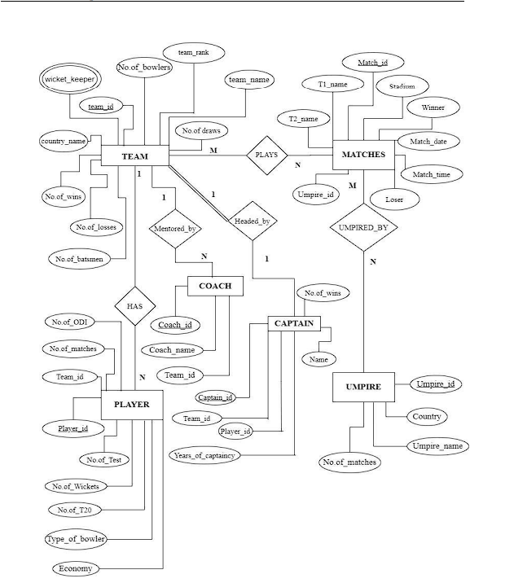
ER Diagram

Slide 5
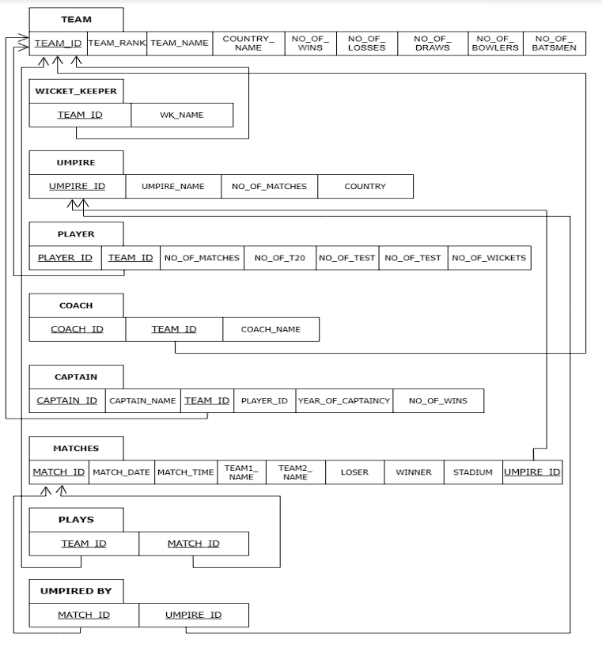
Relational Schema
The term "schema" refers to the organization of data as a blueprint of how the database is constructed. The formal definition of a database schema is a set of formulas called integrity constraints imposed on a database. A relational schema shows references among fields in the database. When a PRIMARY KEY is referenced in another table in the database, it is called a foreign key. This is denoted by an arrow with the head pointing at the referenced key attribute. A schema diagram helps organize values in the database.

